Slide 1
Lecture 14:
Green Parties in Europe
Course: Environment and Politics in India

Slide 2
Conflict areas
Vanashakti advertisements/’A Weapon of Democracy’ (CSD)
‘Wildlife’ lobby versus Tribal lobby. Tigers versus adivasis? Questions of:
  WHO poaches and WHY?
  PROVING that community presence damages wildlife
  WHY and HOW should resettlement happen?
  Recognition of people’s rights over land for resettlement
  Allowing community participation/agreement to resettlement packages
  Providing full facilities are provided at the resettlement site

Slide 3
Conflict areas
Industry lobby versus Tribal lobby. ‘Environment’ lobby often working WITH industry lobby.
FACTS:
  90% of India’s grasslands have been converted to COMMERCIAL Forest Department plantations
  Five lakh hectares of forest converted in five years alone (2001-2006) for mines, dams and industrial projects
  Conversion of millions of hectares of forest for monoculture plantations by the Forest Department
  Proposals to privatise “degraded” forest lands for private companies’ timber plantations

Slide 4
Conflict areas
‘Forest’ lobby versus adivasi lobby. Arguments:
  4 hectares of land to each adivasi family will destroy forests
  ‘Forests’ are arbitrarily designed, Adivasis need rights over forest produce
  FRA will open gates to land grabbing
  WHO should protect forests? Government or forest dwellers? Or BOTH?

Slide 5
MoEF versus MOTA
  November 2012 PMO meeting with MoEF and MoTA: Efforts to dilute powers of the gram sabhas to ONLY consultation.
  MoTA’s concern with the non-implementation of the FRA.
  MoTA’s demands that FRA is not only about “recognising rights”, but equally about adivasis’ right to manage forests THEMSELVES.

Slide 6
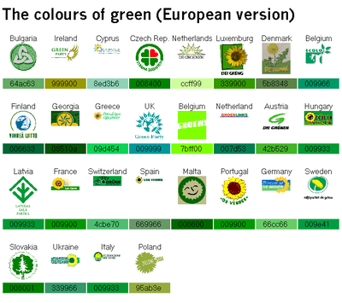

Slide 7
Green Parties in Europe
Most well-known: German Green Party (1980). But NOT the oldest.
1972: "Values Party" in New Zealand. No representation in Parliament due to British-style electoral system.
1979: FIRST representation in a NATIONAL parliament (Switzerland).
1982: Belgium's two Green Parties won seats in their national parliament.
1989 European Parliament elections: Established Green Parties across Europe (lesser growth in Portugal, France and Italy).
  British Greens: 14.5%, NO seats.
  Representation from: Portugal, Spain, France, West Germany, Netherlands.
  Presence in national parliaments: Sweden, Finland, West Germany, the Netherlands, Belgium, Luxembourg, Austria, Switzerland, Italy, Portugal, Malta, Ireland, Greece.
  In Norway,
  Denmark and Iceland, ‘alternative’ parties have taken their space.

Slide 8
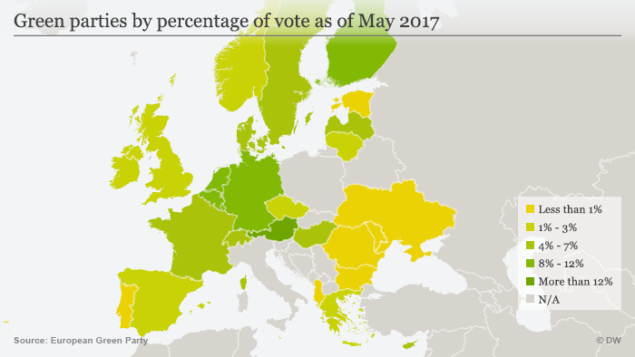

Slide 9
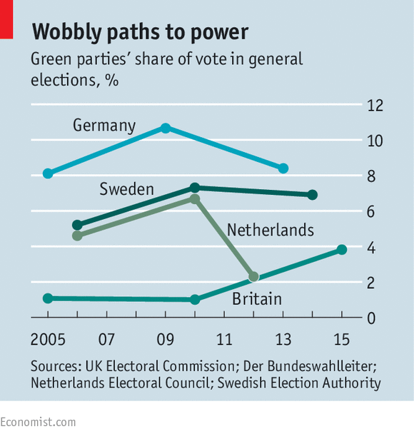

Slide 10
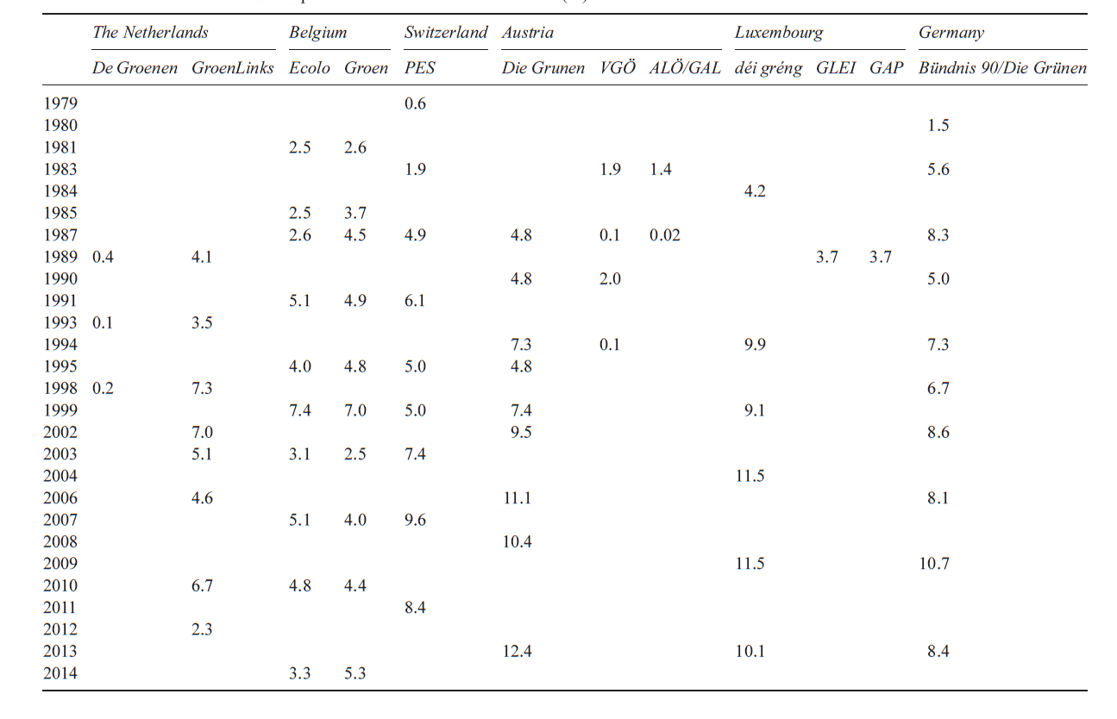

Slide 11
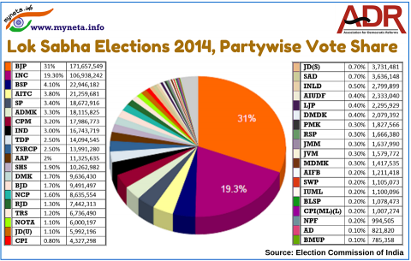

Slide 12
Green Parties in Europe
Erosion of the ‘traditional’ party system in Europe since the 1980s
  Labour movement (Social Democrats, Socialists, Communists)
  Right/Centre (Christian Democrats, Conservatives, Liberals)
  Emergence of ‘middle class’, citizen movement. DECLINE in the powers of the ‘organized’ institutions (church/trade unions)
  ‘NEW’ social movements: Issue-based (not CLASS-based) movements. Questioning the model of ‘unlimited’ economic growth.
  EXAMPLE: Joint submissions in favour of nuclear power by the West German Confederation of Industry and the IGBE Mineworkers and Energy Union in the 1970s.

Slide 13
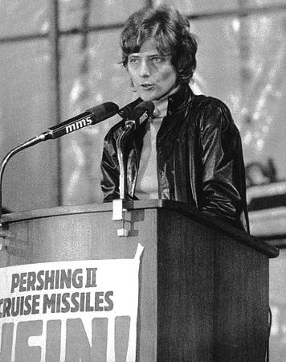
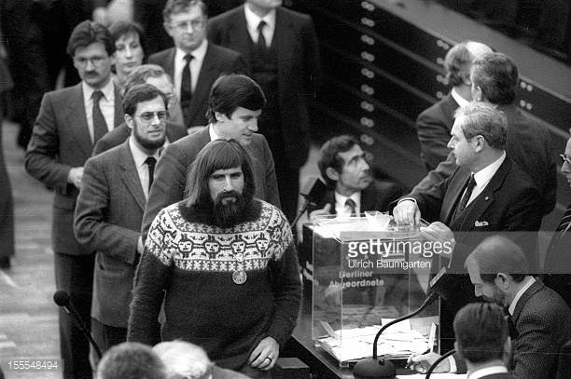
German Green Party
FORMALLY formed in 1980. First election (1979): 3.5%
1983: Entered the German Parliament (>5% of votes)
Opposition to Nuclear Power
Local councils/organisations -> State Parliament -> Federal Parliament
New issues
Heterogonous alliance: former extra-parliamentary activists, former Social Democrats, former Communists, former conservatives, and newly politicized people

Slide 14
Social composition of the European Greens
WHO are part of the Green Party/Green Movement?
Issue-based movement -> All political issues, from social security to civil rights to foreign policy.
New members. Absorbed people coming from different political movements (feminist movement, the Third World solidarity movement, the civil rights movement, etc.)
“Values that must be important for survival of mankind”, rather than for betterment of individual groups
Social basis: Middle class, young and middle-age, women, educated.
Socio-demographically heterogeneous.
Economic Policy: Left-leaning, supporting state intervention
Social policy: Support gender equality, abortion rights, same-sex marriage etc. Individual rights + International Cosmopolitanism
Support more public participation

Slide 15
Green Politics in Europe
4 PILLARS:
a) Ecology b) Grassroots democracy c) Social justice 4) Non-violence
"Ecological policy rejects exploitative forms of economy and the unscrupulous plundering of natural resources and raw materials, as well as the destructive interventions into nature's ability to renew itself. We believe that the exploitation of nature as well as human beings must be stopped if we are to master this acute threat to life on earth." "Both the capitalist and state-socialist form of concentration and monopolization of economic power yield destructive forms of economic growth which contaminate and destroy the very basis of human and natural life. Only by self-determination at the grassroots, the ecological, social and economic crises can be appropriately dealt with. Since we favor self-determination and the free development of every human being, and since we support the idea that people should be able to creatively determine their own needs and wishes free from outside pressure and in harmony with the natural environment, we strongly support human and democratic rights, in our country as well as abroad." - From the Green Party’s 1980 Manifesto

Slide 16
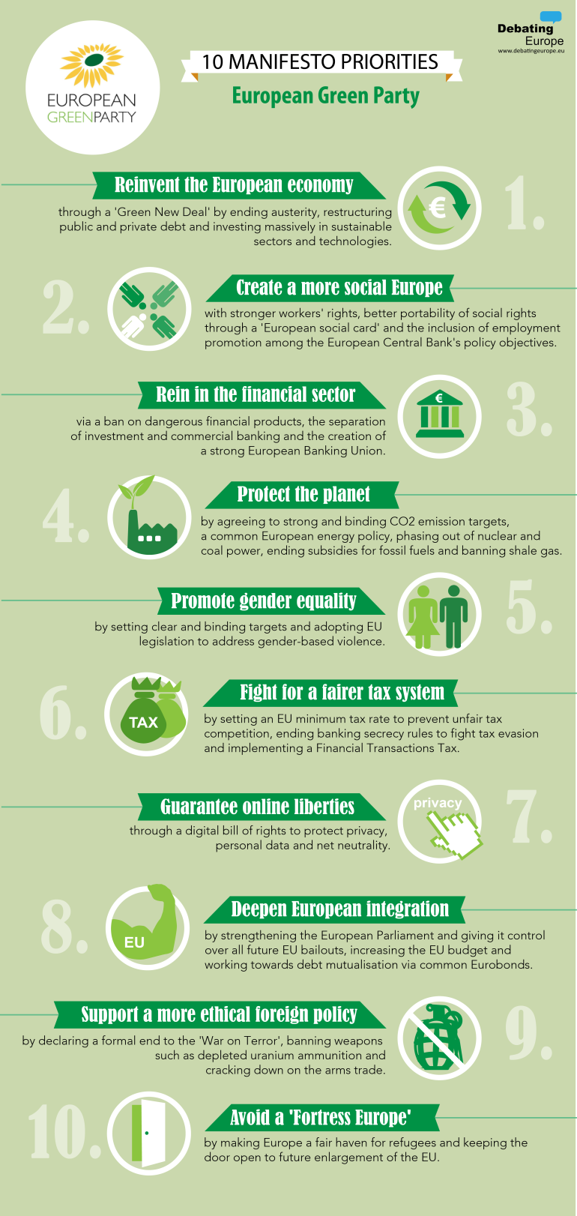


Slide 17
Green Challenge
WHAT is the Green Challenge?
Philosophical: Challenge to an anthropocentric world-view. Push for a bio-centric view (GAIA etc.).
“The politics of the Industrial Age, left, right and centre is like a three-lane motorway, with different vehicles in different lanes, but all heading in the same direction. Greens feel that it is the very direction that is wrong, rather than the choice of any one lane...it is our perception that the motorway of industrialism inevitably leads to the abyss – hence our decision to get off it, and seek an entirely different direction”. – Jonathan Porritt
Programmatic: Challenge to consumerism (spiritual aspect), growth/consumption (economic aspect).
Identified ISSUES:
  Unsustainable lifestyles and economies
  Unresponsive governments and political processes
  Need for mass mobilisation
  Need for NEW, counter-narratives/culture
  CONTRADICTIONS: Ecologists versus Environmentalists.

Slide 18
Green Challenge
WHAT is the Green Challenge?
  CONTRADICTIONS/INFLUENCING conditions:
    State of industrial/economic development
    Nature of POLITICAL competition (single versus multi-party system, nature of ideological divide)
    GREENS as the alternative “LEFT”
    Nature of democratic, political structures
    EXAMPLE: Majoritarian representation parliaments versus Proportional representation parliaments
    Economic incentives for parliamentary participation
    Nature of BUREAUCRATIC structures

Slide 19
Green Challenge
WHAT is the Green Challenge?
    Ecologism versus Environmentalism
    Political participation versus mass mobilisation
    HOW to win? Independent/Coalitions
    HOW to manage party structures, participatory democracy ONCE in power?

